Slide 1
Flow Charts

Slide 2
What is a Flow Chart?
A graphical representation of a routine/process
Made of pure logic to avoid ambiguity
TRUE and FALSE only
Are great for outlining how a program will be coded
Are great for showing “what do I do, and when?”

Slide 3
You go through processes every day

Slide 4
Are they used outside of coding?
Yes! All of the time!
Technicians use them to troubleshoot problems.
If your computer won’t turn on, what’s the first thing you check?
If that thing is ok, then what do you check next?
Businesses use them to outline protocols and policies.
If an engineer wants to buy something, how does his boss approve it, how does management pay for it, and how does shipping now to deliver it to him?
Customer Service reps use them to help you with your problems.
Dungeon Masters use them to organize the effects of events in their worlds.

Slide 5
As a programmer…
Will I use them frequently?
Yes, in large software development companies where teams are common.
Do I have to write one before every program?
No, but it’s highly recommended for large projects with more than one programmer.

Slide 6
Are there other ways to write flow charts?
Flowcharts are just symbols connected by arrows.
Most flowcharts use the same common convention, but each is tailored to its purpose.
Almost all flow charts use the same 4-8 symbols, but there are potentially infinite symbols, depending on your case.
Readability is key. I always avoid making arrows jump over other arrows.

Slide 7
What software can I use?
We use Visio, because the school pays for it.
LibreOffice Draw is open source and free.
code2flow.com converts javascriptish to a flowchart.
There are many online applications.

Slide 8
The shapes

Slide 9
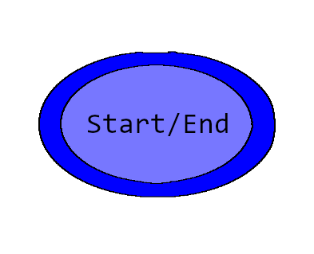
Start / End
The process is beginning or ending
Can have ONE OUTPUT and NO INPUTS XOR… Can have MANY INPUTS and NOT OUTPUTS

Slide 10
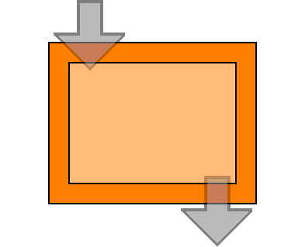
Process Step
Does something without needing any human input
A normal step. Most common.
Can have MANY INPUTS
Can have ONE OUTPUT
Commonly confused with I/O

Slide 11
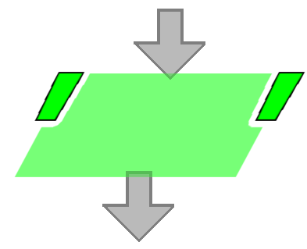
Input / Output
Requires human input OR gives human output
Can have MANY INPUTS
Can have ONE OUTPUT
Most frequently confused with Process Step

Slide 12
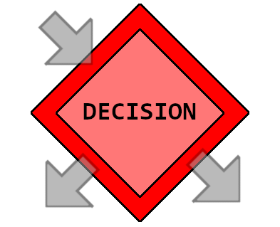
Decision Step
Split the flow of a chart by checking a condition and making a decision
You know them as “if statements”
But they are also while and for loops, among other uses
Can have MANY INPUTS
MUST HAVE AT LEAST TWO OUTPUTS
Output arrows must be labelled as the condition it represents

Slide 13
Other common shapes

Slide 14
Going back to the questions…
When will I use them most?
Large projects with a team
Small feature addon “whitepapers” (a paper explaining what your plan is)
Does the flow chart get edited when adding features?
Only if it effects the core flow of the program.
Otherwise it will probably be a whitepaper
What if it’s a HUGE project?
This is where JUMPS/SUBROUTINES come into play
Abstraction is used to represent many small steps as one big step

Slide 15
Using Jumps:

Slide 16
Abstractions:

Slide 17
What if I have multiple routines?
Then just make multiple flowcharts or jumps, ya dingus.

Slide 18
How to convert flow charts to code?
I’m glad you asked.

